Slide 1
Stress Management
Name:- Jay kakdiya
Enrollment Number:-160410116046
Sem:-3rd
It department

Slide 2
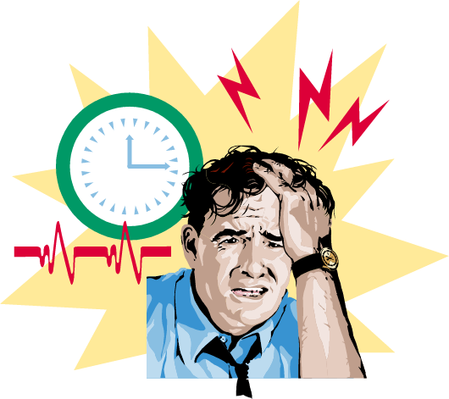
Work Stress and Its Management
Stress
A dynamic condition in which an individual is confronted with an opportunity, constraint, or demand related to what he or she desires and for which the outcome is perceived to be both uncertain and important

Slide 3
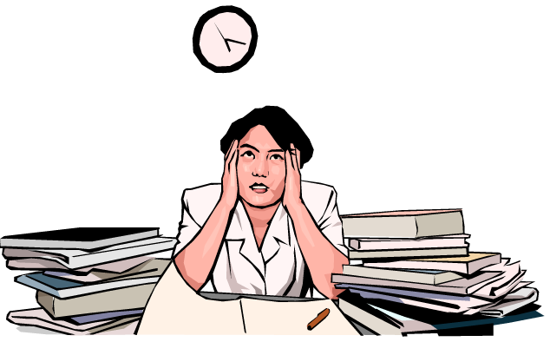
Work Stress and Its Management
Demands
The loss of something desired
Resources
Things within an individual’s control that can be used to cope with demands

Slide 4

Potential Sources of Stress
Environmental Factors
Economic uncertainties of the business cycle
Political uncertainties of political systems
Technological uncertainties of technical innovations
Terrorism in threats to physical safety and security

Slide 5
Potential Sources of Stress (cont’d)
Individual Factors
Family and personal relationships
Economic problems from exceeding earning capacity
Personality problems arising from basic disposition
Individual Differences
Perceptual variations of how reality will affect the individual’s future
Greater job experience moderates stress effects
Social support buffers job stress
Internal locus of control lowers perceived job stress
Strong feelings of self-efficacy reduce reactions to job stress

Slide 6
Consequences of Stress
High Levels of Stress
Physiological Symptoms
Psychological Symptoms
Behavioral Symptoms

Slide 7
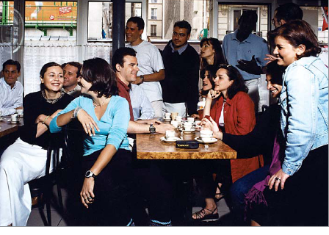
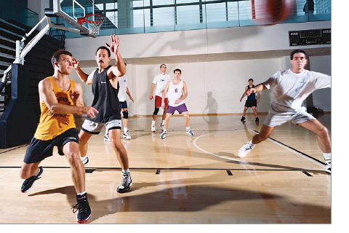
Managing Stress
Individual Approaches
Implementing time management
Increasing physical exercise
Relaxation training
Expanding social support network

Slide 8
Managing Stress
Organizational Approaches
Improved personnel selection and job placement
Training
Use of realistic goal setting
Redesigning of jobs
Increased employee involvement
Improved organizational communication
Offering employee sabbaticals
Establishment of corporate wellness programs

Slide 9
Case study
Google is one of most successful company in tell-communication filed in entire world.
Headquarter of goole is at California.Google give facility to what they want to do they can do

Slide 10

Case study
At Google headquarter all facility
comfort for the employees like
rest room,canteen,play ground,etc
Theri are no pressure of authority
on employees for work. Employees
can do there work any time.

Slide 11
Thank Tou

